Slide 1
Cobol 5 Tables
Joe Oakes
jxo19@psu.edu

Slide 2
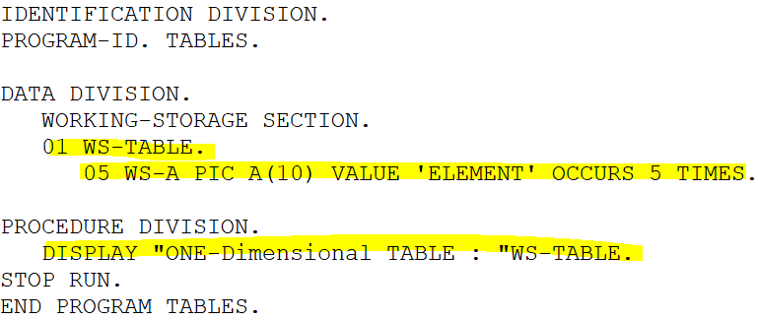
Cobol: Tables: One Dimensional Table
A table is a collection of data items
A table consists of a table name and table elements
A table is similar to an Array in other programming languages
An Array is a linear data structure
An Array is a collection of individual data items of the same type
You can use subscripts or indexes to refer to individual items in the table
Define the table in the Data Division
Running Example

Slide 3
Cobol: Tables: One Dimensional Table
The Occurs clause is used to define the table
It defines the repetition of the data name
It can only be used with level numbers between 02-49
You can define a one-dimensional or two-dimensional table

Slide 4
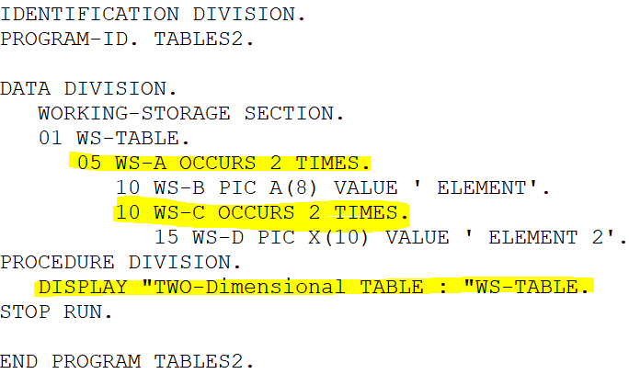
Cobol: Tables: Two Dimensional Table
A Two-dimensional table is created with both data elements being a variable length.
Running Example

Slide 5
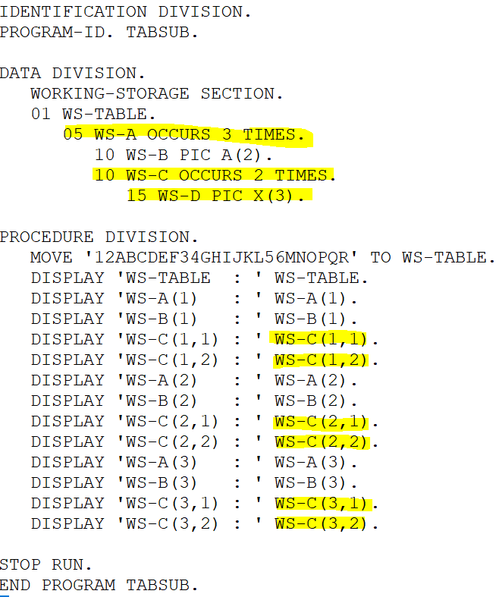
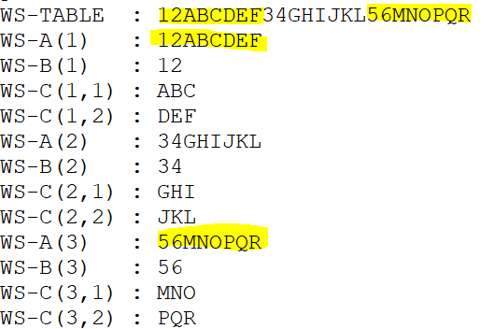
Cobol: Tables: Subscript
Running Example
Table elements can be accessed by using a subscript
The values can range from 1 to the number of times the table occurs
A subscript can be any positive number
You don't have to declare it in the DATA DIVISION
Notice the working storage variables elements the subscript reference gets the values
WS-C(1,1), WS-C(1,2)
WS-C(2,1), WS-C(2,2)
WS-C(3,1), WS-C(3,2)

Slide 6
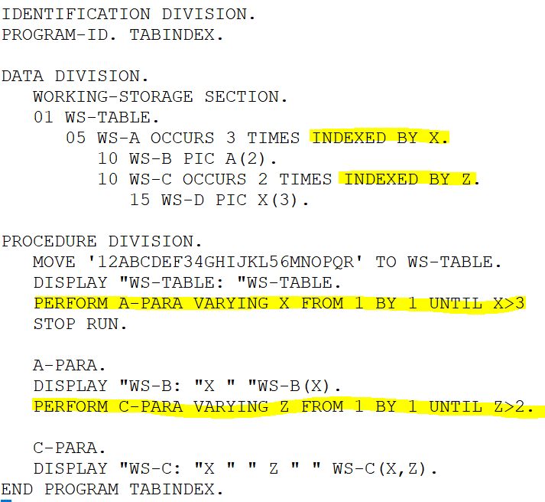
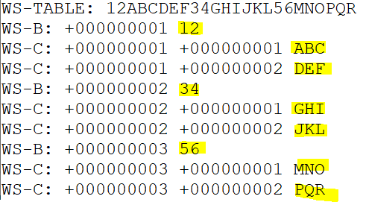
Cobol: Tables: Index
Running Example
Table elements can also be accessed by using index
It is a displacement of the element from the start of the table
It is declared with the OCCURS using the INDEXED BY clause
The value of the index can be changed using the SET statement and PERFORM
Notice WS-B occurs 3 times
Notice WS-C occurs 2 times per element
Notice the working storage variables element values
WS-C:1,1, WS-C:1,2
WS-C:2,1, WS-C:2,2
WS-C:3,1, WS-C:3,2

Slide 7
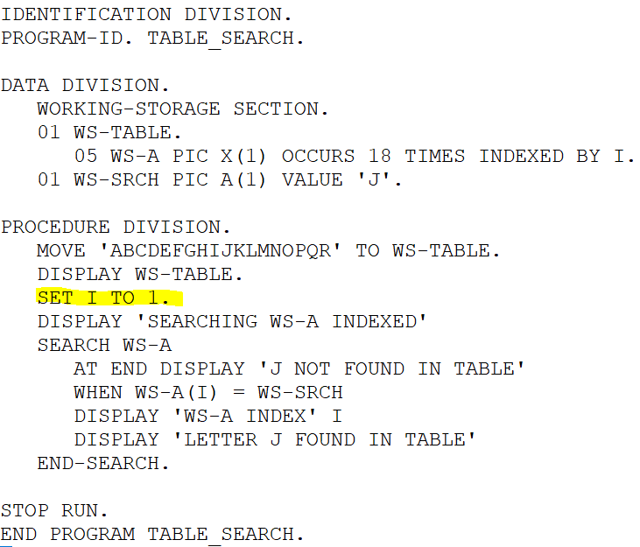
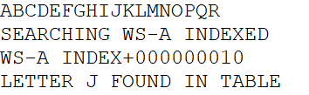
Cobol: Tables: Set
Running Example
Set statement is used to change the index value
It can be used to initialize increment, or decrement the value of the index
It is used with Search and Search All to locate elements in a table

Slide 8
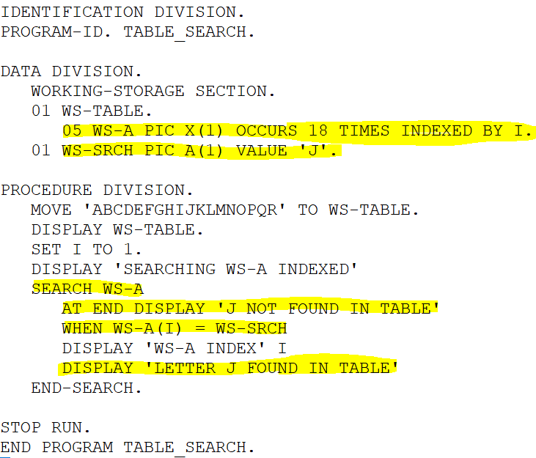
Cobol: Tables: Search
Running Example
Search is a linear search method used to find elements in a table
It can be used on sorted and unsorted tables
It should only be used on tables declared with the INDEX phrase
It starts with the initial value of the index and increments automatically by 1 until it reaches the end of the table

Slide 9
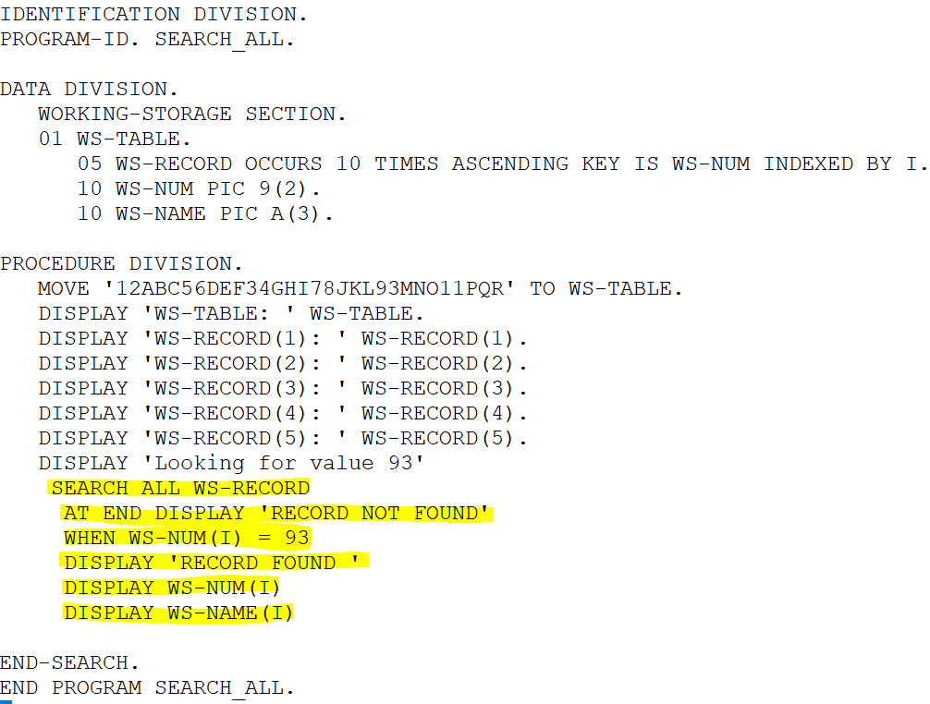
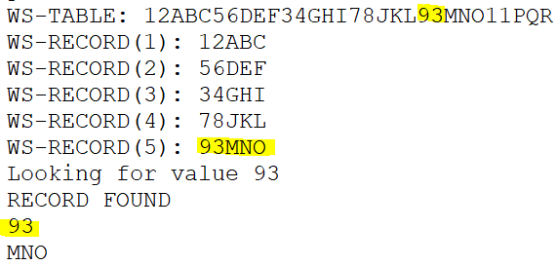
Cobol: Tables: Search All
Running Example
Search All is a binary search method used to find elements in a table
The table must be sorted
The index does not require initialization
It halves the table and determines in which half the element is located
It will repeat until the element is found of the end is reached

